Slide 1
Understanding SEND Funding
New to role SENCO Resource
MODULE 4 – May 2021

Slide 2
Module objectives
To understand your notional budget
How and when to apply for element 3 funding for children with an education health and care plan
Understanding what your element 3 funding is for, and when you will get paid.
Raise awareness of resources available to support you as a SENCO
Provide details of where to go for further information, help and advice

Slide 3
SEND Funding
Top up – pupil specific agreed case by case (exceptional needs)
Funding to support pupils based on a pre-determined band value (element 3)
Place funding – equates to c£4,000 per pupil (elements 1)
Notional funding – equates to c£6000 per pupil (element 2)
Top-up – pupil specific agreed case by case (element 3)
Notional funding – equates to c£6000 per pupil (element 2)
Place funding – equates to c£4000 per pupil (element 1)
Special schools and enhanced resource
Mainstream

Slide 4
Element 1 – core school budget
Schools get most of their funding based on the total number of pupils in the school.
Every pupil in a school attracts an amount of money. The amount varies from one authority to another. There is usually more funding for each pupil in a secondary school than in a primary school.
This is the core budget for each school, and it is used to make general provision for all pupils in the school including pupils with SEN.
In Derby this usually equates to about £4000 per pupil

Slide 5
Element 2 – the notional SEN budget
The government suggests that schools should use this notional SEN budget to pay for up to £6,000 worth of special educational provision to meet a child’s SEN. Most children with SEN need special educational provision that comes to less than £6,000.
Reminder: special educational provision is anything that is ‘additional to or different from’ the provision that is made for all children. Provision which is for all children is funded from the core budget.
Element 2 is called the notional SEN budget because no-one tells you exactly how you should spend the money. When funding is delegated to schools, you can spend it in the way you think is best.
However, remember you have a duty to identify, assess and make special educational provision for all children with SEN

Slide 6
Element 2 – the notional SEN budget
Every school receives an additional amount of money to help make special educational provision to meet children’s SEN.
The amount in this budget is based on a formula which is agreed between schools and the local authority. The formula gives more money to schools based on:
Prior attainment
EAL
IDACI (your local deprivation index figure)
Free School Meals
Mobility
You may find you have many more children with SEN than expected. This might happen where, for example, you have a good reputation for teaching children with SEN.

Slide 7
Element 3 - Top-up funding
NOT EVERYONE WITH AN EHC PLAN NEEDS ELEMENT 3 FUNDING
Top-up funding is the funding required, over and above the core funding you receive, to enable a pupil or student with high needs to participate in education and learning.
It is intended to support high needs students staying in a mainstream setting
It should reflect the costs of additional support to meet the individual pupil or student’s needs.
Top-up funding can also reflect costs of facilities required to support a pupil’s education and training needs.

Slide 8
Applying for funding
An E3 request form must be submitted if you need top-up funding
You can request funding either:
At the start of the plan
After a annual or interim review
It must be re-applied for annually if you still need the funding
Applications must link directly to the provision set out in the plan
You must demonstrate how notional funding will be used and how the amount requested is in excess of that expenditure.

Slide 9
The process
Application from setting
Decision making by officer
Approval from manager
Inputting for payment
School is notified
Quarterly schedule and Payment

Slide 10
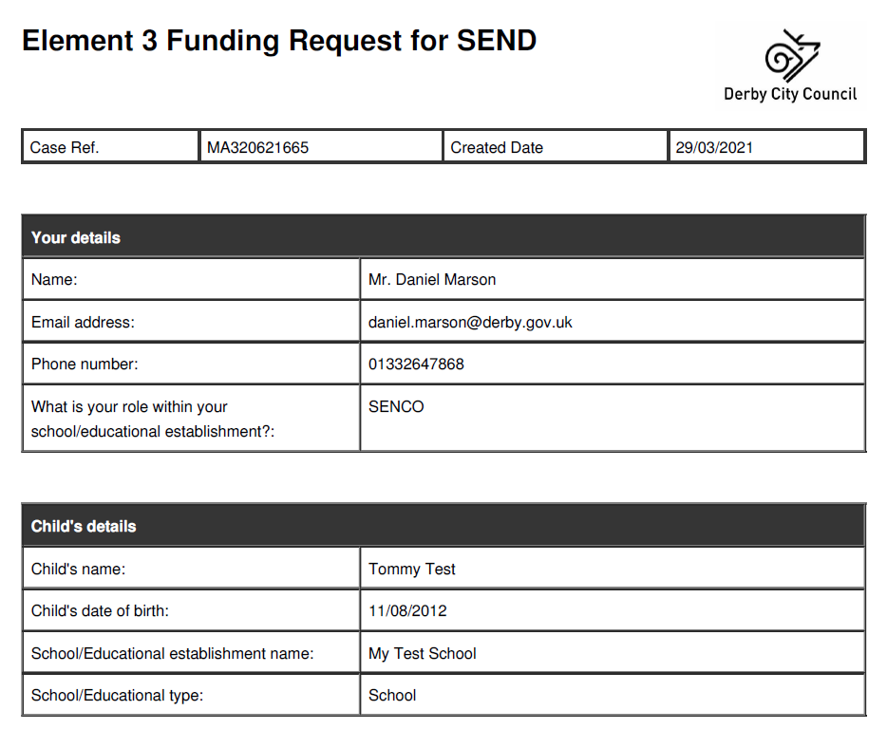
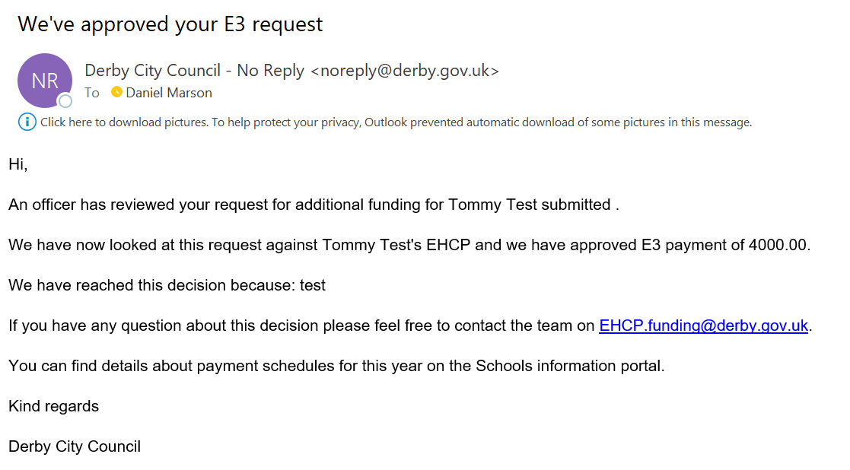
Making a request
You can access the online funding form here: https://myaccount.derby.gov.uk/service/element_3_funding_request_for_send
Instructions for SENCOs have been updated here: https://schoolsportal.derby.gov.uk/sen/element-3-top-up-funding/
If you create an account you will be able to access all other requests that they have submitted in the past 12 months.
When you submit the request you will receive an email confirmation including a PDF of the form they have submitted, should you wish to save one in the Child’s file
The email give the you a reference number.

Slide 11
Remember . . .
Only provision listed in section F of the EHCP will be paid for. If you think the plan needs updating, then call a review
E3 isn’t just for TA costs.
If the child lives outside of Derby City you will need to apply to that local authority for any top-up funding. Each authority does this slightly differently
TA costs will only be paid up to a maximum of £15.60 per hour
If you require additional funding mid-year, it will indicate either the child's needs have changed, or your school's ability to meet those needs has changed. In either case this should always trigger a review of the plan.
Funding will not automatically be awarded just because a child was getting E3 in their previous school
E3 won’t be awarded for a period where there is no plan in place e.g. during the assessment period
Always check your quarterly statement
Notes:
Make sure everyone has access to EHCP.Funding@derby.gov.uk mailbox

Slide 12
School budgets - tips
Provision mapping is key – understand your whole SEND budget and use this to maximise the resources you have, reducing the need for top-up funding
Keep interventions under review – check value for money and progress against outcomes
Call reviews if needs change, outcomes are not being met and additional or different provision is needed. Reviewing a plan is the mechanism for accessing different funding
Monitor your quarterly funding statements – make sure it has everyone listed that you expected

Slide 13
Resources
The schools information portal
Guide to high needs funding
Derby City school finance and budget page
Where to go for help
Your linked EHCP Officer if it relates to E3 funding
The school finance team
Your school business manager or MAT Inclusion lead
SEND Ambassadors

Slide 14
And finally, don’t forget the role you play in our
local area vision for SEND

