Slide 1
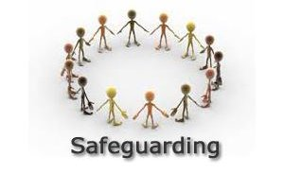
Safeguarding Children
A Guide for School Staff
Issued on 20th April 2020

Slide 2
Covid-19: Interim Period
These slides are for use by schools during Covid-19. They do not replace the requirement for staff to complete the Introduction to Safeguarding e-learning course (which is currently being updated) or Everybody’s Business (Level 3) for designated safeguarding leads and their deputies.
Please ensure you refer to the government guidance issued to schools alongside these slides.
Schools and colleges should continue to have regard to Keeping Children Safe in Education (2019) and Working Together to Safeguard Children (2018).

Slide 3
Covid-19: Interim Period (cont)
A number of safeguarding principles remain the same:
always act in the best interest of the child
anyone with a safeguarding concern about any child should continue to act immediately
a DSL or deputy DSL should be available
unsuitable people must not be allowed to enter the children’s workforce and/or gain access to children
children should continue to be protected when they are online

Slide 4
What I must do and know
Read and understand the child protection policy.
Read and understand the staff code of conduct policy.
Read and understand Keeping Children Safe in Education, Part 1 and Annex A (KCSIE 2019).
Know what the categories of abuse are and recognise the possible indicators of abuse.
Know how to report a concern about a child and make a referral.
Know the procedures for reporting a concern about an adult.
Know who the Designated Safeguarding Lead and Deputy DSLs are, as well as who the Safeguarding Governor is.
Be able to access e-safeguarding systems if you have one.
Know where to find information and guidance.
Notes:
All staff should

Slide 5
Child Protection
Attendance and CME
Keeping safe online
Whistle-blowing
SEND
Safeguarding
Managing Allegations
and promoting
Curriculum
welfare
Health and Safety
Behaviour management
Safer recruitment
Premises and security
Staff code of conduct
Notes:
What is safeguarding like in school:
We can see here some of the various elements of safeguarding that are related to school governance/functioning.
Safeguarding in schools includes all internal policies and procedures. Regard also needs to be given to local and national policies, procedures and legislation.

Slide 6
Key Legislation
A3
Working Together to Safeguard Children (2018) A guide to inter-agency working to safeguard and promote the welfare of children
Keeping Children Safe in Education (2019) Statutory guidance for schools and colleges
Information Sharing (2018) Advice for practitioners providing safeguarding services to children, young people, parents and carers
Notes:
Working Together to Safeguard Children 2018
11. The following have duties in relation to safeguarding and promoting the welfare of children: governing bodies of maintained schools
12. This guidance applies in its entirety to all schools.
13. Schools, colleges and other educational settings must also have regard to statutory guidance Keeping Children Safe in Education, which provides further guidance as to how they should fulfil their duties in respect of safeguarding and promoting the welfare of children in their care
KCSIE 2019
Key changes:
Part One: Safeguarding Information for all Staff
27. Definition of Upskirting has been added “taking a picture under a person’s clothing without them knowing, with the intention of viewing their genitals or buttocks to obtain sexual gratification, or cause the victim humiliation, distress or alarm” (DfE, 2019a). This is now a criminal offence.
29-30. Serious Violence: all staff in schools and colleges should be aware of indicators, which may signal that children are at risk from, or are involved with serious violent crime
Part two: The management of safeguarding
69-75. Local safeguarding boards will have been replaced – DSCB is now Derby & Derbyshire Safeguarding Children Partnership (DDSCP)
89. Changes to RSE curriculum. Opportunities to teach safeguarding Schools should consider opportunities for teaching safeguarding as part of a broad and balanced curriculum. This can be covered through Relationships Education and Relationships and Sex Education (formerly known as Sex and Relationships. The government has made regulations which will make Relationships Education (for all Primary pupils) and Relationships and Sex Education (for all Secondary pupils) and Health Education (for all pupils in state funded schools) mandatory from 2020 (The Relationships Education, Relationships and Sex Education and Health Education (England) Regulations 2019).
91. Changes to Ofsted. Inspection From September 2019 Ofsted will carry out inspections of early years, schools and post-16 provisions under the Ofsted’s Education Framework (Ofsted, 2019a). Inspectors will always report on the effectiveness of safeguarding arrangements and Oftsed has published specific guidance on this entitled Inspecting safeguarding in early years, education and skills (Ofsted, 2019b).
Part three: Safer recruitment Updates to schools' and colleges' legal duty to refer to the Disclosure and Barring Service (DBS) anyone who has harmed, or poses a risk of harm, to a child or vulnerable adult. were made on 1 October 2019.
164. Exiting staff States that the DBS will consider whether to bar the person and includes a link to guidance on when to refer and which information should be provided.
165. Existing staff States that referrals should be made as soon as possible and includes: more information on when referrals should be made and information on what to do when an allegation is made, including carrying out an investigation and ensuring there is enough information to meet the referral criteria set out in the DBS referral guidance.
Annex A. Honour-based violence text has been made clear that this kind of abuse includes FGM and Forced Marriage
Annex C. Online Safety. New link to government guidance Teaching online safety in school (DfE, 2019c) has been added which outlines how schools can ensure pupils understand how to stay safe online
Information Sharing 2018
The GDPR and Data Protection Act 2018 do not prevent, or limit, the sharing of information for the purposes of keeping children and young people safe.
Where practitioners need to share special category personal data, they should be aware that the Data Protection Act 2018 includes ‘safeguarding of children and individuals at risk’ as a condition that allows practitioners to share information without consent

Slide 7
Categories of abuse
A3
There are four categories of abuse defined in Working Together to Safeguard Children (2018)
Neglect
Physical abuse
Emotional abuse
Sexual abuse
Children are more likely to be abused by people they know, although staff should have regard to contextual safeguarding (KCSIE 2019) and Working Together (2018):
“As well as threats to the welfare of children from within their families, children may be vulnerable to abuse, or exploitation from outside their families.” (Working Together 2018)
Notes:
Neglect:
Persistent failure to meet child’s physical and/or psychological needs resulting in impairment of health or development. Failure to provide food, clothing and shelter, protecting a child from harm, inadequate supervision, lack of access to medical treatment.
Physical:
Hitting, shaking, throwing, poisoning, burning, scalding, drowning, suffocating or other harm or fabrication of an illness.
Emotional:
Making the child feel worthless or unloved, inadequate, deliberating silencing them, making fun of them, overprotection or limitation of exploration appropriate to the child’s development, serious bullying, including cyberbullying, causing a child to feel frightened or in danger.
Sexual:
Forcing or enticing a child to take part in sexual activities. May include masturbation, kissing, rubbing, touching on outside of clothing. Also includes non-contact involving children looking at or in production of sexual images, watching sexual activities, encouraging children to behave sexually or grooming a child for abuse. This can be online. Sexual abuse by other children.

Slide 8
Other Safeguarding Issues
All staff should be aware of other safeguarding issues and how they can support children. These include:
Children Missing from Education
Children with Family Members in Prison
Children at Risk of Exploitation
Domestic Abuse
Homelessness
Managing Allegations against Staff
Online Safety
Peer on peer abuse
Private Fostering
Vulnerable Children
Notes:
This is not an exhaustive list – please refer to Keeping Children Safe in Education (2019) and your school’s policies

Slide 9
Stopping Domestic Abuse Together (SDAT)
A3
The Home Office has published guidance highlighting help and support available to victims of domestic abuse during the coronavirus outbreak in England.
Schools/colleges will continue to receive domestic abuse notifications via the Stopping Domestic Abuse Together (SDAT) initiative
Notifications will continue to be recorded in the children’s safeguarding file.
The school/college will take steps to ensure the child is safe and will review what they know about the child and their family. If the child is expected to attend school/college the usual checks should be made on their welfare.
What is known about the child when they arrived (or not) at school/college today?
Who in the school/college needs to be informed?
What ‘checks’ need to be carried out and how best can these be achieved?
Are they in school today? How are they presenting physically and emotionally? Are there any changes in their behaviour?

Slide 10
Stopping Domestic Abuse Together (SDAT)
A3
If a child is not expected to be in schools/college, consideration should be given as to how you can seek assurance on their welfare and what checks can be made.
In all cases the school/college will make general enquires with the child about how they are.
The domestic abuse notification should not be referred to unless it is directly mentioned by the child or where the parent/carer raises the issue.

Slide 11
Concerns about a member of staff or volunteer
The school’s procedures should be applied when there is an allegation or concern about the conduct of a member of staff or volunteer who may have:
Behaved in a way that has harmed a child, or may have harmed a child
Possibly committed a criminal offence against or related to a child
Behaved towards a child or children in a way that indicates they may pose a risk of harm to children.
Notes:
All staff should know what to do if they have a concern and should follow the school’s procedures
Member of staff or volunteer Report to the Headteacher
Headteacher Report to the Chair of Governors

Slide 12
Local Authority Designated Officer (LADO)
From 1st April 2020 LADO Child Protection Managers will not be providing telephone advice and will expect referrers to have reviewed the procedures and make a written referral to the LADO if they assess that there has been an allegation of harm to a child by an adult in a position of trust.
After this time there will be routine follow up discussions with the referrer to ensure that the best course of action is put in place to respond to the concern in line with safeguarding and LADO procedures.
Derby: cypsafeguarding@derby.gov.uk
Derbyshire: professional.allegations@derbyshire.gov.uk.
Derby City: 01332 642376
Derbyshire: 01629 533190

Slide 13
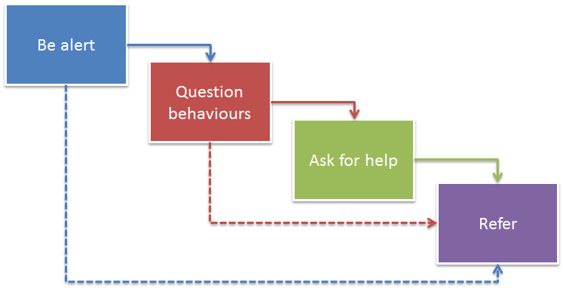
What is expected of us?

Slide 14
Derby City and Derbyshire Threshold Document Providing effective multi-agency support December 2019 – Derby City

Slide 15
Derby City and Derbyshire Threshold Document Providing effective multi-agency support December 2019 - Derbyshire

Slide 16
Information Sharing
Effective information sharing underpins integrated working and is a vital element of both early intervention and safeguarding.
Wherever possible, practitioners should seek consent and be open and honest with the child and family from the outset as to why, what, how and with whom, their information will be shared
Consent to share must be explicit and freely given
In some circumstances it is not appropriate to seek consent.
Please refer to local and national guidance.
Notes:
16
In some circumstances where it is not appropriate to seek consent (putting a child at immediate risk of harm)
Where a decision to share information without consent is being considered, a discussion should take place with the practitioners manager or safeguarding lead to agree the action to be taken
A record of the discussion, decision making and a record of what has been shared, or not shared, should be kept

Slide 17
When and how to share information
Notes:
Taken from Information Sharing; advice for practitioners providing safeguarding services to children, young people, parents and carers (2015) HM Government, page 12 – an is also included in Derby and Derbyshire Safeguarding Children Boards’ Information Sharing Agreement and Guidance for Practitioners Nov 2015.
If there are concerns that a child is suffering or likely to suffer harm, then follow the relevant procedures without delay. Seek advice if unsure what to do at any stage and ensure that the outcome of the discussion is recorded.

Slide 18
Please remember…
No one has ever been prosecuted for sharing too much information when safeguarding is the issue

Slide 19
Assessment Tools to support referrals
A7
Assessment Tools support staff in providing supporting evidence to meet thresholds when making referrals.
Neglect and Graded Care Profile
Derby and Derbyshire CRE Risk Assessment Toolkit
DASH Risk Identification Checklist
Domestic Violence Risk Identification Matrix (DVRIM)
Brook Sexual Behaviours Traffic Light Tool
Notes:
These assessment tools are updated at regular periods. Please check DDSCP’s procedures on line for up to date assessment tools.

Slide 20
Referrals (Derby City)
If there is an immediate risk of significant harm, contact the Police on 999.
Urgent safeguarding concerns:
Derby City: 01332 641172 opt 1 (Mon to Fri 09:00 – 17:00)
Out of hours: 01332 786968 (Careline)
All telephone referrals need to be followed up by an Online Referral (24 hours)
https://myaccount.derby.gov.uk/en/service/report_concerns_about_a_child

Slide 21
Referrals (Derby City)
For Non Urgent Safeguarding Referrals the Online Referral Form should be used– a follow up telephone call is not required at this stage.
If further information is required you will be contacted by a member of the team. If you provide an email address you will receive an automated response acknowledging receipt of your Online Referral, once a decision has been made, you will be sent an automated email advising of the outcome.

Slide 22
Referrals (Derbyshire)
If there is an immediate risk of significant harm, contact the Police on 999.
For all safeguarding concerns:
Starting Point: 01629 533190
All telephone referrals need to be followed up by an Online Referral (24 hours)
https://www.derbyshire.gov.uk/social-health/children-and-families/support-for-families/starting-point-referral-form/starting-point-request-for-support-form.aspx

Slide 23
When Referring in…..
Child/ren name & DOB
Address? Any siblings?
What happened and when? How?
Did you see these things personally or has someone told you about them?
Has it happened before? How often?
Was there harm/injury to the child(ren)?
If there is an observed injury please obtain a clear description from the person who has seen this.
What has happened since then?
Who did what? How did they interpret this?
Have you taken any action?
Do you have consent from parents?
1st language of family?

Slide 24
If you're unsure?
Refer to the Threshold document or for advice contact:
Professional Consultation Line for advice on
Derby City: 07812 300329 (Mon-Fri 10:00 – 13:00)
Starting Point Consultation & Advice Service
County: 01629 535535 (Mon-Fri 08:00 – 18:00)

Slide 25
Window of Opportunity
If a family has been closed to an allocated social worker or children’s practitioner from a locality team in the last 3 months there is a ‘window of opportunity’ to refer to the same social worker/children’s practitioner
If you know that a family is already open to social care and there is an immediate concern contact the worker, the duty worker or the team manager directly. There will always be someone covering the team.
If a disabled child is open to the Lighthouse and there is a child protection concern contact the Lighthouse (Tel: 01332 256990. Email: thelighthouse@derby.gov.uk

Slide 26
On Line Referral Form Children in Need criteria
When considering the Threshold Document, if the family meet Children In Need criteria; please ensure that you have discussed the referral with Parents/Guardian and obtained consent prior to make the referral.
A competent child over 13 years can give their own consent to a referral

Slide 27
Responding to Safeguarding Concerns during Covid-19
A3
This information is in line with current national guidance and the Derby and Derbyshire Safeguarding Children Procedures. Additional measures set out below accompany the specific sections of the local procedures - Making a referral to Children’s Social Care and S47 procedures. At this challenging time it is vitally important that agencies continue to work together and share relevant safeguarding information to keep children safe
Contacts & Referrals
If you are concerned about the welfare of a child or young person or are worried they are being abused, you should make a referral to Children's Social Care. Wherever practicable, contact should be indirect, such as by telephone/video call or using the online referral form. For the continuing role of educational establishments see Coronavirus (COVID-19): guidance for schools and other educational settings

Slide 28
Responding to Safeguarding Concerns during Covid-19
A3
Assessment: Early Help and Children in Need (CIN)
Unless there are serious concerns that a child is suffering or likely to suffer abuse and maltreatment, practitioners should use an Early Help Assessment to start the process of understanding the needs and strengths of the child and the parent / carers.
For updates on the latest position on CIN & Early Help and for Core Group/TAF meetings for Derby City and Derbyshire please visit the DDSCP website here
Professional Judgements about visiting children and families to complete children in need assessments will balance considerations about:
risks to children and young people
risks to families
risks to the workforce

Slide 29
Responding to Safeguarding Concerns during Covid-19
A3
There may be circumstances where it will be necessary for professionals to visit children in person. Where face-to-face work is deemed necessary, practitioners should take account of Public Health England (PHE) advice on social distancing and minimising the spread of infection to keep safe both themselves and the family they are visiting.
Staff should follow their own internal procedures and risk assessments as well as taking national guidance into account if carrying out home checks.

Slide 30
Responding to Safeguarding Concerns during Covid-19
A3
Strategy Discussions
Strategy discussions should be held by virtual means in order to co-operate with social distancing guidance requirements. The purpose of the strategy discussion / meeting is to determine the child's welfare and plan rapid future action if there is reasonable cause to suspect the child is suffering, or is likely to suffer, Significant Harm.
Child Protection Conferences
Multi-agency child protection conferences will be held using technologies such as conference telephone / video calls to enable contact to be indirect.
For updates on the latest position for Child Protection Conferences and medicals for Derby City and Derbyshire please visit the DDSCP website.

Slide 31
Early Help Assessments (Derby City)
During the Covid-19 period, a virtual VCM is operating. Telephone support from EHA Advisors is also available. Early Help forms and guidance can be found here.
Completed forms should be sent to:
Locality 1 and 5 vcm1and5@derby.gov.uk
Locality 2
vcm2@derby.gov.uk
Locality 3 and 4 vcm3and4@derby.gov.uk
Early Help Advisors:
Locality 1 and 5 01332 640723
01332 641047
Locality 2 01332 715636
Locality 3 and 4 01332 641183
Young Carer’s Early Help Advisor:
Mandala Flash 01332 641017
mandala.flash@derby.gov.uk
Notes:
If you find parents will not engage virtually but you have concerns, please ring and ask for support and advice.

Slide 32
Safeguarding and remote education during Covid-19
A3
National guidance published on 19th April 2020 sets out key information on keeping teachers safe when providing remote education.
Remote education is a new experience for both staff and pupils, so it’s important that schools understand how to approach safeguarding procedures online.
Schools may wish to use these resources to understand more about ensuring online education is safe:
remote education advice from The Key for School Leaders
advice from NSPCC on undertaking remote education safely
guidance from the UK Safer Internet Centre on remote education

Slide 33
Remote Working
A3
Remote Working and Use of Technology
It is important to note that personal data must at all times continue to be processed and stored in accordance with Data Protection principles. Data Protection and Coronavirus: What You Need to Know (Information Commissioner’s Office)
You should not use personal devices to communicate with service-users, store personal data on personal devices or download and use apps onto work or personal devices (phones/laptops/tablet computers) without express authorisation from your manager. If using video calls consider beforehand the following best practice:
All parties have prepared for the call (if possible) and are suitably dressed in an appropriate location;
If privacy is needed to talk to a child or carer, how this will be raised and where should it happen?

Slide 34
Derby and Derbyshire Safeguarding Children Partnership Multi Agency Dispute Resolution and Escalation Policy November 2019
Children’s safety can only be assured and their welfare promoted where practitioners work respectfully together, sharing responsibility for case management and decision making, challenging appropriately and ensuring all relevant perspectives are explored.

Slide 35
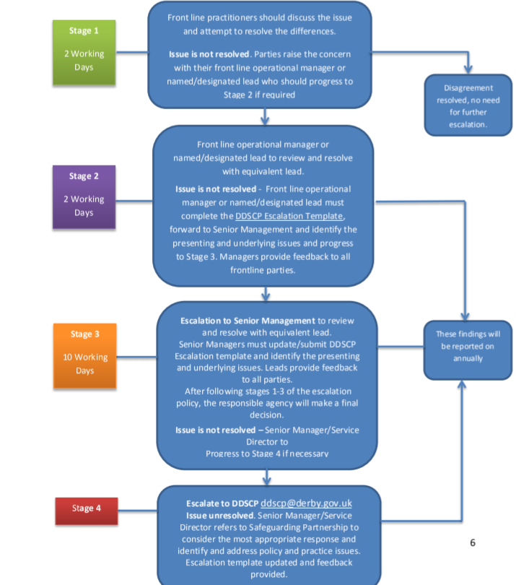
Derby and Derbyshire Safeguarding Children Partnership Multi Agency Dispute Resolution and Escalation Policy November 2019

Slide 36
Safeguarding Files
Keep accurate records and update chronologies.
Remind staff to:
Always use professional language
Reporting should be factual
All concerns, disclosures or incidents must be recorded and shared with the DSLs
Actions taken should be in line with DDSCP procedures and with your internal policies
Notes:
36

Slide 37
Signs of success in safeguarding
Children and learners are protected and feel safe.
They can identify a trusted adult.
Adults listen to them and take concerns seriously.
Concerns are shared, recorded and acted on.
There are clear procedures for children who go missing.
Children know how to get support if they experience discrimination.
Well developed strategies to keep children safe online.
Positive behaviour is promoted consistently.
Robust safer recruitment procedures.
Guidance for Ofsted Inspectors (September 2019)

Slide 38
https://www.ddscp.org.uk/

